Slide 1
#03 Arrays and Collections
Notes:
Give an explanation for the concepts array and collections
Relevant theoretical decisions
What is an array, for what and how is it used?
What is an ArrayList, for what and how is it used?
What is the difference between an ArrayList and an array?
Which other collections (Map, List, ...) have you knowledge about?
What do you understand by the concept generic type, how is it used and what is its purpose?
What is a foreach loop and what is its purpose?

Slide 2
Class

Slide 3
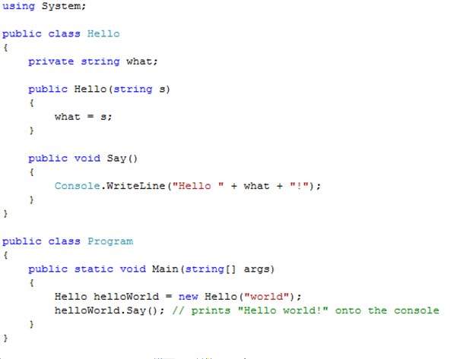
Class Example and Visibility

Slide 4

Interfaces
“An interface is a contract that guarantees to a client how a class will behave”
A Class can implement more the one interface
Interfaces can be extended and combined

Slide 5
Abstract Class

Slide 6
Abstract Class Vs Interface

Slide 7
Garbage Collector
C# performs automatic garbage collection
Collection/removing objects that are marked as garbage
Object that no longer has a reference
C# programmers don’t need to worry about explicitly reclaiming memory that has become garbage

Slide 8
Use in our program

Slide 9
Use in our program

